Slide 1
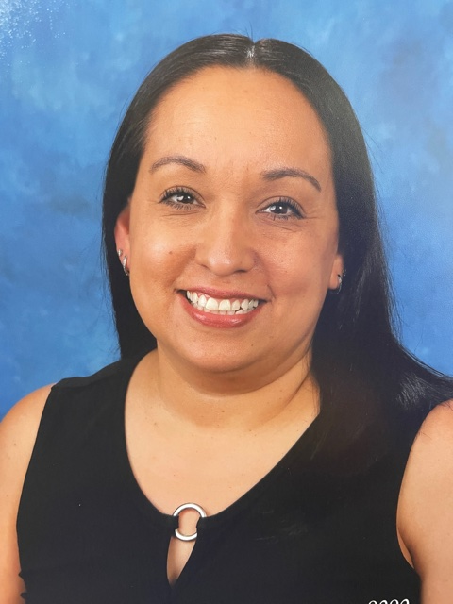
Meet Your Teacher
About Me:
Mrs. Marin
Welcome to the 2024-2025 school year. I have been teaching students with Autism for 14 years, I have one son, Julian who is 7 years old and in Second grade here at Country Springs. I look forward to what this new year will bring us!
My Favorites:
~Purple, grey, and blue
~Chocolate
~Dr. Pepper
~Starbucks
~Target
~Dodgers
~USC Trojans
Contact Me:
Jennifer_marin@chino.k12.ca.us
Class Dojo

